Slide 1
Project Progress Report: SmartLogger
Anuska Kundu
Manika Mittal
Manoranjan Maharana

Slide 2
Overview
Project start date:
May 26, 2020
Progress so far
Overview of previous interns’ work
Problem statement identification
Data extraction and Preprocessing
Future Goals
An efficient alerting system for exception logs and a dashboard for obtaining various statistics pertaining to the logs

Slide 3
Progress - Week 1
Understanding the role and duty of the E-Support Team.
Understanding the Support tab of Dell website and evaluating the means to improve the ESupport services, thereby enhancing CSAT score.
Understanding the tools used by the team like Kibana, Splunk, etc.
Understanding the work done by the winter interns on the 3 projects:
Comment Classification
Auto install logs dashboard
Manual install logs
Suggesting possible extensions to the projects to improve their accuracy, functionality and efficiency.

Slide 4
Progress - Week 2
Identification of Problem statement for our project in discussion with the Project Architect.
Learning to work with Kibana to extract logs for a specified period.
Studying the dataset of logs to understand the various fields, patterns, and variations.
Applied Data processing algorithms to group the extracted logs based on application names.

Slide 5
Progress - Week 3
Thorough study of Kibana logs to identify the key data fields relevant to our use case.
Learning to work with Kibana to extract logs for a specified period.
Applied Data Preprocessing algorithm to clean the log dataset of irrelevant information like stack trace, codes, etc. Our aim was to trim the log to a precise form.
We analyzed all logs of 24 hours and studied it to identify the possible patterns for classifying all logs. We found a lot of anomalies in the formatting, but broadly, we classified logs in 2 layers:
Layer 1: Classification based on log level: infi, error, warn
Layer 2: Further grouping of logs of each level such that the logs of a given group could be extracted through a definite regular expression (regex).
.

Slide 6
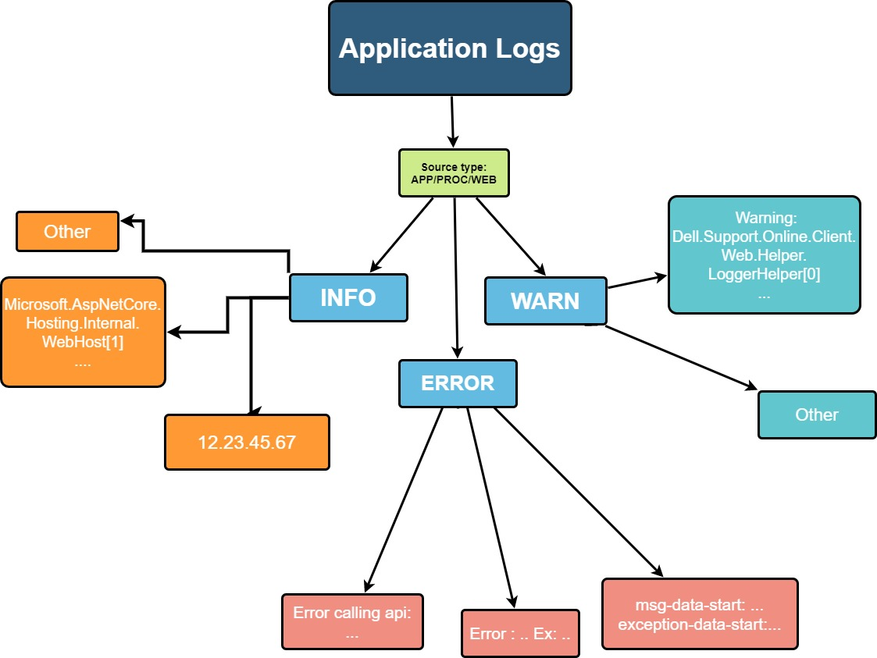

Slide 7
Progress - Week 4
Based on the insights from other team members, our next task was to work on extracting the error logs of 15 UX applications, preprocessing them, and filtering out the user-specific information in the logs.
We accomplished the same generalisation of error logs of the given applications by dividing the logs amongst the 3 of us, owing to the different kind of formatting of logs of each application.
We developed algorithms for the applications assigned to each one of us and aggregated the results to get the desired information:
Error message
Exception name (without user specific data)
Exception details

Slide 8
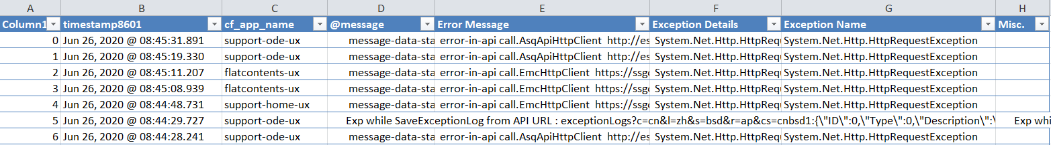
Progress - Week 4
User data was filtered out of the logs so as to ease the process of counting the number of occurrences of a particular kind of exception in a prespecified duration.
We accomplished the same generalisation of error logs of the given applications by dividing the logs amongst the 3 of us, owing to the different kind of formatting of logs of each application. The logs which didn’t obey an particular formatting were put in a Miscellaneous category.

Slide 9
Schedule

Slide 10
Dev: Week 5
Dev: Week 3
29.06.20
06.07.20
13.07.20
20.07.20
Dev: Week 4
Review + Reporting

Slide 11
Tools and Softwares Used
Python
Regex
Kibana
Github
Microsoft Excel

Slide 12
Github
All three of us have been collaborating using Github. The details of our work, spreadsheets and code samples can be found at this private repository:
https://github.com/manikamittal2898/SmartLogger

Slide 13
Future Goals:
Creating an API for our algorithm which automatically queries Kibana suitable.
Developing an alerting system for our application by linking it to Microsoft Teams
Developing a dashboard for our application

Slide 14
Thank You

